Slide 1

PawSystem
G7T3 — Agnes, Chantel, Ming Miao, Nicolas, Pei Yi, Yu Jie
Notes:
Hey every one, we are G7T3. Our group consists of Agnes, Chantel, Ming Miao, Nicolas, Pei Yi and Yu Jie. Our group will be presenting to you PawSystem.

Slide 2
Background of PawS System
PawS System aims to be a one-stop platform for all fragmented pets services app in the market. It provides the various functions not limited to
Booking Services
Payment Service
Manage Provider Services
Notes:
So here is a brief background of the PawS System. This system aims to be a one stop platform for all fragmented pets services app in the market. So just think of it like a platform with many pet service providers in Singapore. Users can book the services, make payment for the services. As for the Pet Service Provider, they will also be able to add their own service that they will provide.

Slide 3
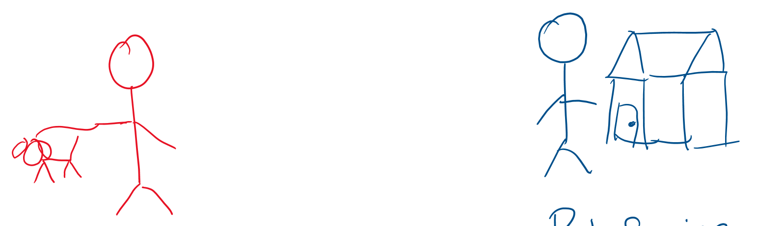
Actors
Pet Service Provider
Customer
(with pets)
Notes:
The 2 actors (users) of this system will be the customer (with pets) and the pet service provider

Slide 4
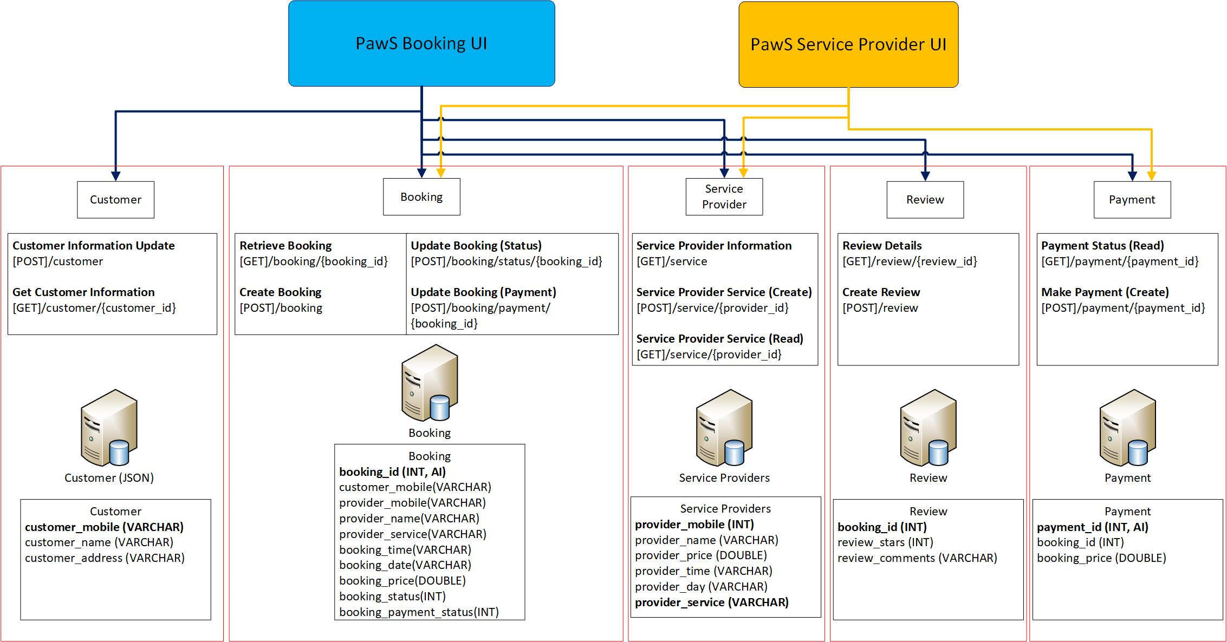
Technical Overview Diagram
Notes:
Customer, Service Provider, Review and Payment microservices are atomic. Booking microservices is composite as it takes value from customer and service provider. From the slide we can see the databases and records used.

Slide 5
User Scenarios
Customer Manages Booking (Create)
Service Provider manages Booking (Completes Booking)
Customer Reviews (Create)
Customer makes Payment (Create)
Service Provider Acknowledges Payment (Update)
Notes:
We have 5 user scenarios. Here, all the scenarios will cover roughly the main flow of the customers’ journey from creating the booking to providing the review of each booking.
Other scenarios such as the viewing payments are not listed here, but we will show them to you during the demonstration.

Slide 6
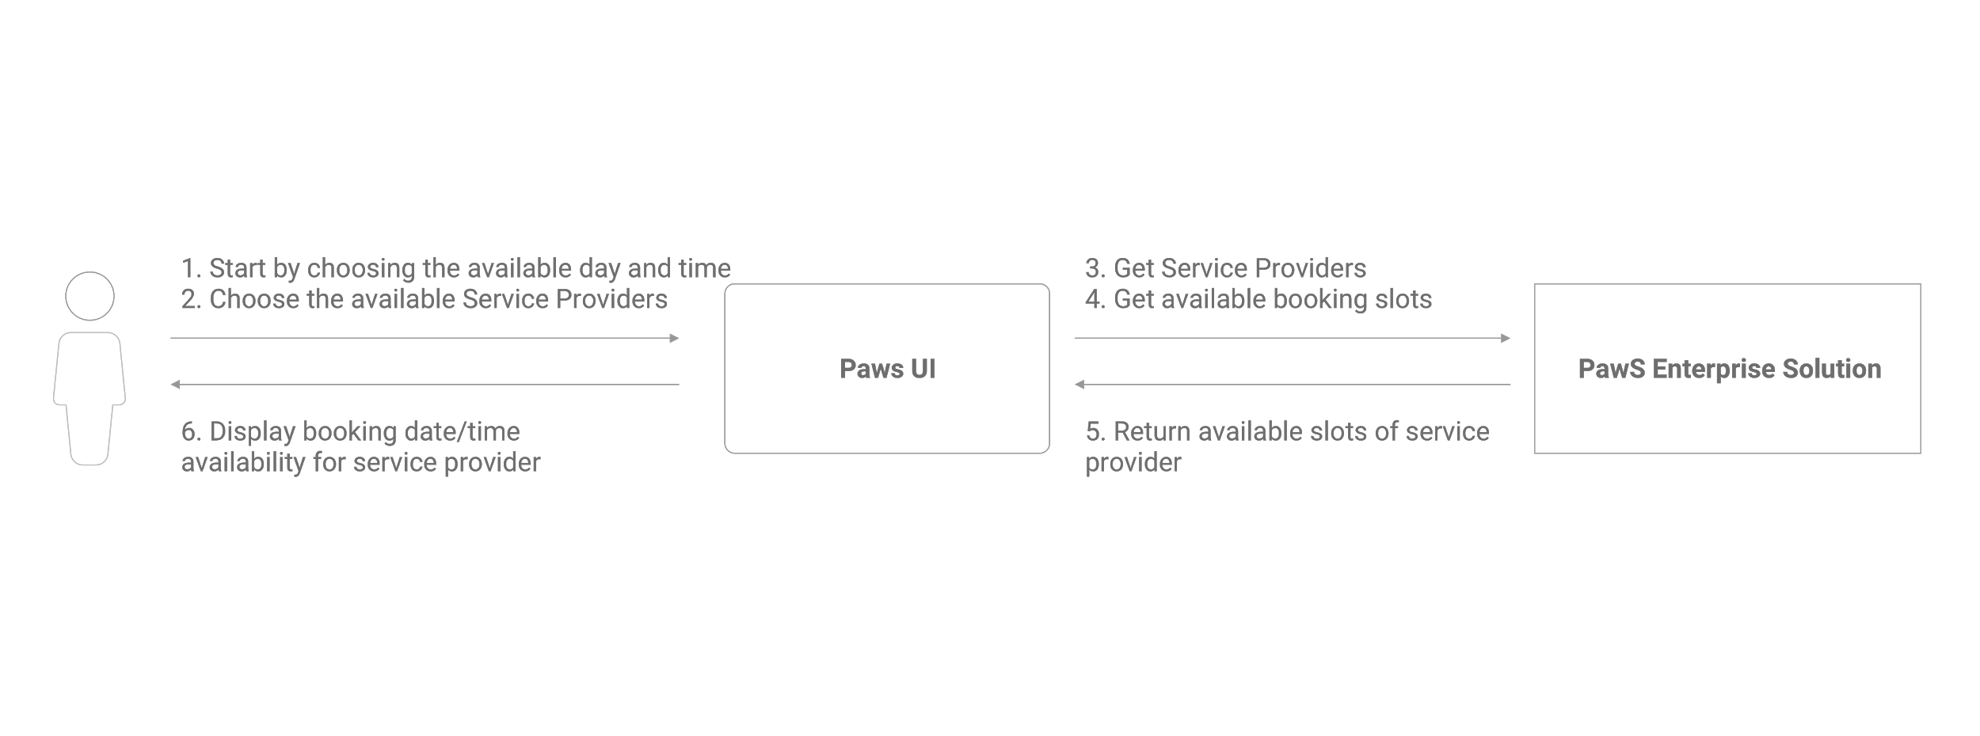
Customer manages booking
Notes:
1. Customer will be able to access the list of service provider and their availability.
2. Upon receiving this UI request, PawS UI then sends a GET request to PawS Enterprise Solution to get the list of service providers as well as the available slots.
3. PawS Enterpise Solution then sends a reply message back to PawS UI containing the list of available slots of the different service providers.
4. The PawS UI then displays the booking date and time availability of the service provider to the customer.

Slide 7
Microservices
Service Name | Description of the functionality | Operational information (e.g., HTTP URL or AMQP exchange type and keys, if any) | Input (if any) | Output (if any)
Booking (Docker container) | Get a list of available = bookings | HTTP [GET] /booking/<string:customer_mobile> | none | {booking_id, provider_name, bookingDate,booking_time,booking_price}
 | Update booking status | HTTP [POST]/booking/status/<string:booking_id> | {booking_id} | Successful status
Customer | Receive update | AMQP type: Direct Routing keys: customer.update | none | {"status": resultstatus, "message": "Always successful", “customer": customer }
Service Provider | Get a list of service providers day/time and services provided | HTTP [GET] /serviceprovider | none | "serviceProviders": [ { "provider_day": "fri", "provider_mobile": "1", "provider_name": "Agnes", "provider_price": 45.0, "provider_service": "Feeding", "provider_time": "18:00" } ]
Notes:
1. Passenger starts the booking request by selecting his available day and time as shown on the PawS UI. Thereafter, the UI will show the passenger a list of available Service Providers he can choose from based on his availability. Passenger chooses amongst the list of Service Providers.
2. Upon receiving this UI request, PawS UI then sends a GET request to PawS Enterprise Solution to get the list of service providers as well as the available booking slots.
3. PawS Enterpise Solution then sends a reply message back to PawS UI containing the list of available slots of service provider.
4. The PawS UI then displays the booking date and time availability for service provider to the passenger.
For this scenario, the Booking and Customer microservices are heavily used, also the Service Provider microservice too. The Booking microservice is packaged into a docker container where the service will listen to port (insert port num here) to run the request. In the Customer UI, the Ui will display the Customer Details (such as …) and Booking Details (such as…). Therefore two microservices are used in this scenario. In order for the customer to choose the day/time, the Service Provider day/time and service will be displayed first, and all the customer needs to do is to select that booking.

Slide 8
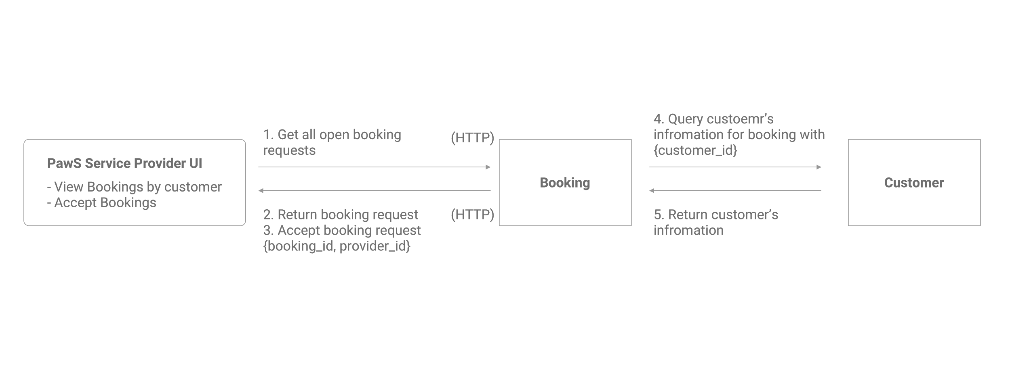
Service Provider manage booking
Notes:
1. Passenger starts the booking request by selecting his available day and time as shown on the PawS UI. Thereafter, the UI will show the passenger a list of available Service Providers he can choose from based on his availability. Passenger chooses amongst the list of Service Providers.
2. Upon receiving this UI request, PawS UI then sends a GET request to PawS Enterprise Solution to get the list of service providers as well as the available booking slots.
3. PawS Enterpise Solution then sends a reply message back to PawS UI containing the list of available slots of service provider.
4. The PawS UI then displays the booking date and time availability for service provider to the passenger.

Slide 9
Microservices
Service Name | Description of the functionality | Operational information (e.g., HTTP URL or AMQP exchange type and keys, if any) | Input (if any) | Output (if any)
Booking | Get a list of available = bookings | [GET] /booking/<string:customer_mobile> | none | {booking_id, provider_name, bookingDate,booking_time,booking_price}
 | Update booking status | [POST]/booking/status/<string:booking_id> | {booking_id}
Customer | Receive update | AMQP type: Direct Routing keys: customer.update | none | {"status": resultstatus, "message": "Always successful", “customer": customer }
Notes:
1. Passenger starts the booking request by selecting his available day and time as shown on the PawS UI. Thereafter, the UI will show the passenger a list of available Service Providers he can choose from based on his availability. Passenger chooses amongst the list of Service Providers.
2. Upon receiving this UI request, PawS UI then sends a GET request to PawS Enterprise Solution to get the list of service providers as well as the available booking slots.
3. PawS Enterpise Solution then sends a reply message back to PawS UI containing the list of available slots of service provider.
4. The PawS UI then displays the booking date and time availability for service provider to the passenger.
For this scenario, after the customer has completed the service that is provided by the service provider, the service provider will update the customer’s booking to complete. This is so that the job is complete and the customer is able to make a review.

Slide 10
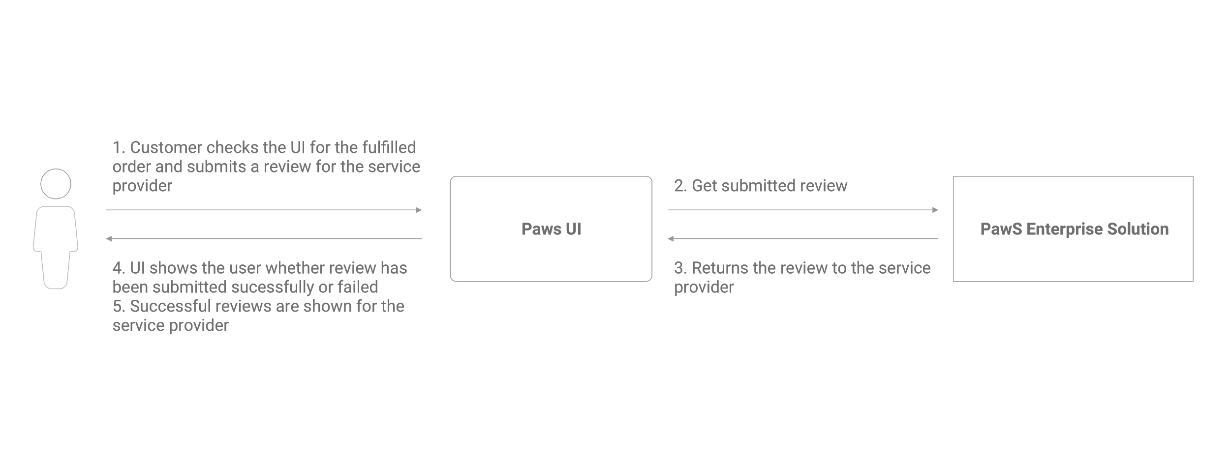
Customer creates Review
Notes:
1. The customer checks the UI for the fulfilled order and submits a review to the service provider.
2. The PawS UI then gets the submitted review from the PawS Enterprise Solution. The PawS Enterprise Solution returns the review to the service provider.
3. The UI then shows the customer the submit status of the review. Successful reviews are shown for the service provider.

Slide 11
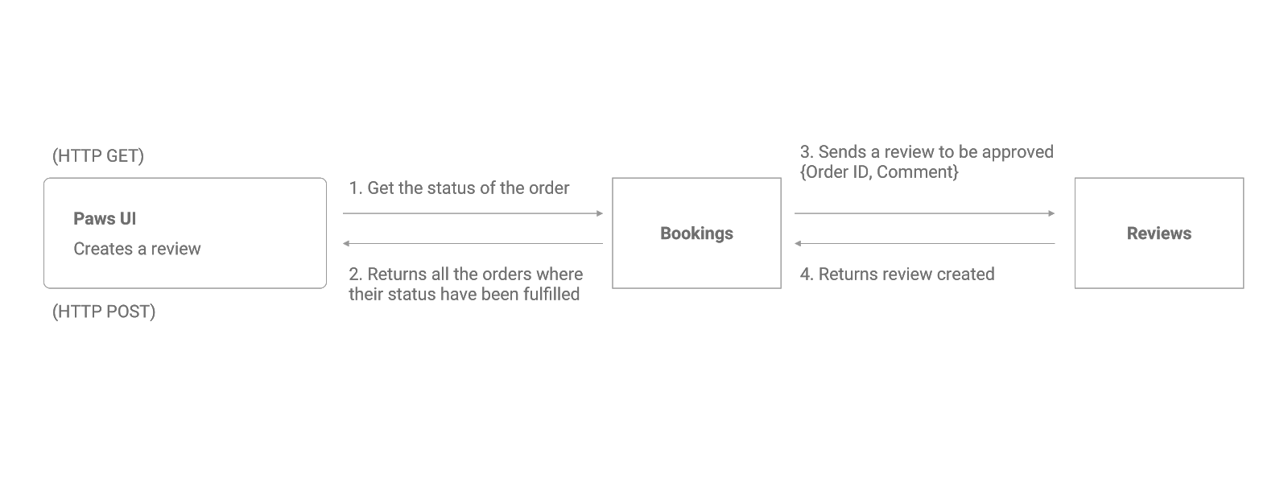
Customer creates Review
Notes:
1.The PawsUI sends a HTTP GET message to the Orders microservice to retrieve orders that had their statuses fulfilled. The Orders microservice sends back a reply message to PawS UI.
2. Next, PawS UI sends a review containing Order ID and comment, to the Reviews microservice using HTTP POST. The Reviews microservice returns the created review back to the Paws UI.
For this, the customer will use the UI to make a review for the list bookings that the customer made previously. Customer will then leave the review comments and stars, thereafter submit review and the Review MS will handle this request through HTTP.

Slide 12
Microservices
Service Name | Description of the functionality | Operational information (e.g., HTTP URL or AMQP exchange type and keys, if any) | Input (if any) | Output (if any)
Booking | Get a list of available bookings | [GET] /booking/<string:customer_mobile> | none | {booking_id, provider_name, bookingDate,booking_time,booking_price}
Customer | Create review | [GET]/customer_amqp/login/<string:customerMobile> | {customerMobile}
Review | Get a list of available bookings | [POST]/review/<string:booking_id> | {booking_id, review_star,review_comment}
Notes:
As mentioned, there will 3 MS that will be used for this scenario. When we retrieve data, we will use the get method. When we insert the data (review comments and stars) we will use the POST method. The MS will return the status of the request to the Customer UI.

Slide 13
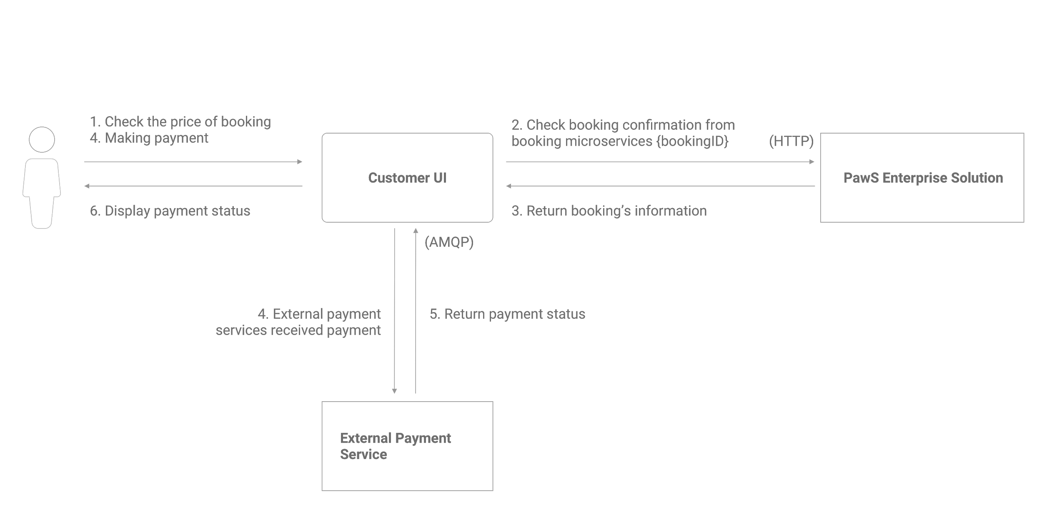
Customer makes Payment
3. Retrieve selected booking info
5. Update Booking Pay Status
2. Select Booking
5. Make Payment
1. Retrieve All Bookings
4. Selected booking info
5. External Payment services received payment
6. Payment Status
Notes:
1. The customer checks the price of his booking on the Customer UI.
2. The customer UI sends a HTTP request message to the booking microservice to get the booking confirmation status for the customer’s booking. The message contains the customer’s booking ID.
3. The booking microservice returns a reply message consisting of the customer’s booking information.
4. Next, the customer proceeds to make payment on the Customer UI.
5.Using AMQP protocol, the Customer UI sends a request message to the external payment service informing the service about the customer’s payment.
6.The external payment service then sends back a reply message containing the payment status of the customer.
7.The Customer UI displays the payment status to the customer.
From the booking page, the customer will find the bookings which he had not paid yet and select that booking for payment. That action will redirect the customer to the payment page that will be used by the API. The Stripe Payment API will receive the transaction made in the web page. The validation will be made by the API’s build. Upon success, it will notify the user to go back to the booking page.

Slide 14
Microservices
Service Name | Description of the functionality | Operational information (e.g., HTTP URL or AMQP exchange type and keys, if any) | Input (if any) | Output (if any)
Customer | Update booking status | [Post]/payment/<string:payment_id> | {booking_id} | {booking_id, provider_name, bookingDate,booking_time,booking_price}
Stripe Payment API | Validating payments | Charge.php will POST to the Stripe’s DB | {First_name, Last_name, Card_details} | Successful status

Slide 15
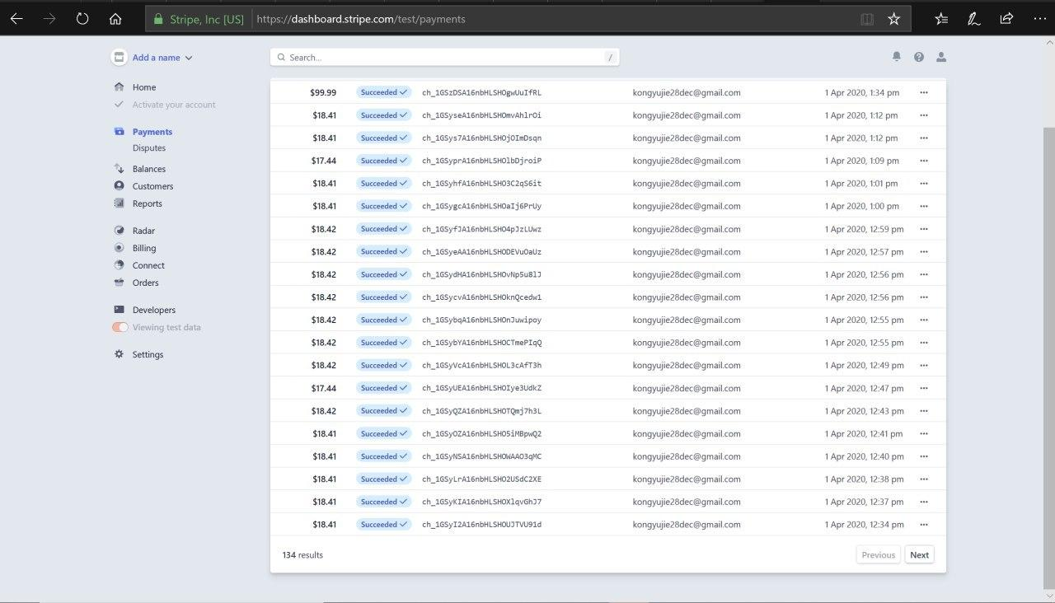

Slide 16
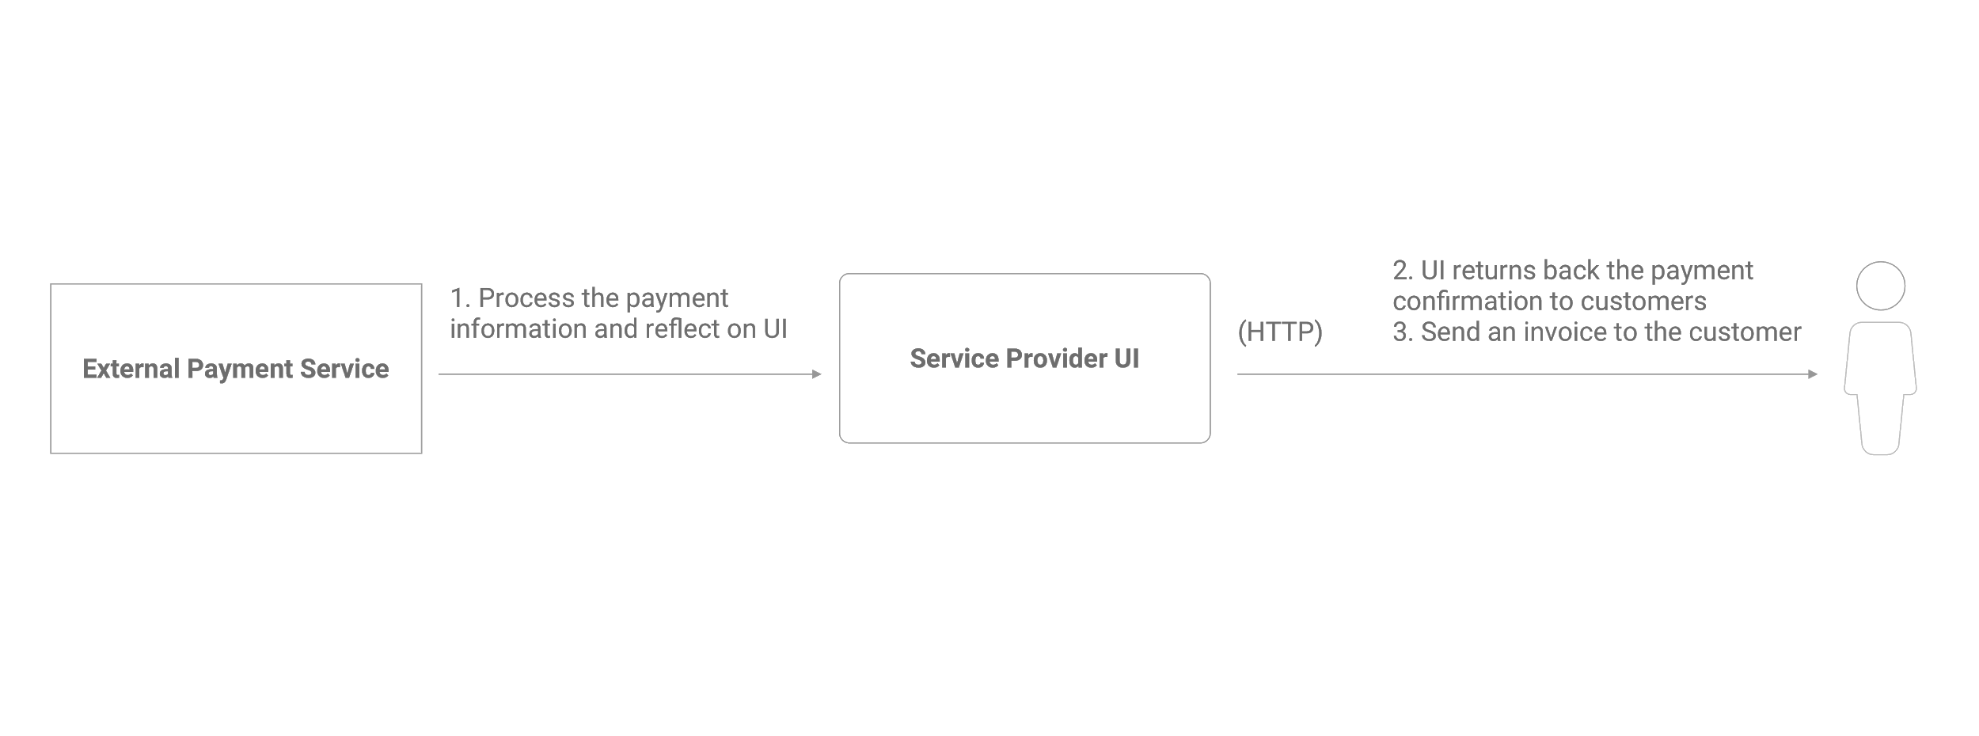
Service Provider acknowledges payment
Notes:
1.The external payment service processes the payment system processes the payment information and this is being reflected on the UI.
2. The UI then sends a HTTP request message to the customer containing the payment confirmation details, as well as an invoice.
Service provider will take a look at the payments which will be retrieved from the payment service.

Slide 17
Microservices
Service Name | Description of the functionality | Operational information (e.g., HTTP URL or AMQP exchange type and keys, if any) | Input (if any) | Output (if any)
Payment | Create payment | [Get]/payment/<string:payment_id> | {payment_id} | {{booking_id, provider_name, bookingDate,booking_time,booking_price}
Notes:
For this case, the payment microservice will be used to return the data into the Service Provider UI.

